Slide 1
Generative Adversarial Networks (GANs)
Zhaokai Huang

Slide 2
Adversarial Training
A phrase whose usage is in flux; a new term that applies to both new and old ideas
Current usage: “Training a model in a worst-case scenario, with inputs chosen by an adversary”. Typically, generator + discriminator.

Slide 3
Auxiliarily, to learn factorial codes
by adversary.
Predictability Minimization (J Schmidhuber, ‎1992)

Slide 4
Roadmap
Why study generative models?
How do generative models work? GANs and its variants?
Research frontiers

Slide 5
Why study generative models?
Simulate possible futures for planning or simulated RL
Realistic generation tasks
Missing data
Semi-supervised learning

Slide 6
Why study generative models?
Simulate possible futures for planning or simulated RL
Realistic generation tasks
Missing data
Semi-supervised learning

Slide 7
Creative applications of GANs to RL
Adversarial Learning for Neural Dialogue Generation (Li, Jiwei, et al., 2017), getting rewards by ways of trained discriminator in GANs, rather than trial-and-errors.
The way to pass Turing Test?
Generative Adversarial Imitation Learning (OpenAI, 2016). The agent learns from example demonstrations, eliminating the need to design a reward function.
Notes:
Adversarial Learning for Neural Dialogue Generation https://zhuanlan.zhihu.com/p/25027693

Slide 8
Why study generative models?
Simulate possible futures for planning or simulated RL
Realistic generation tasks
Missing data
Semi-supervised learning
Notes:
iGan,
Image-to-image translation

Slide 9
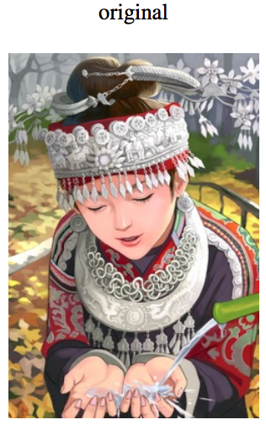
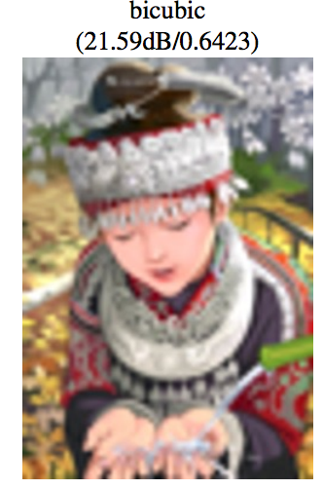
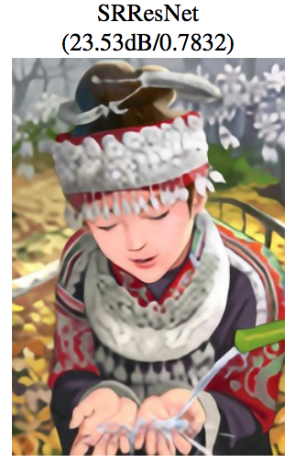
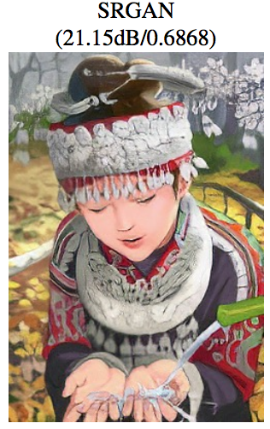
Single Image Super-Resolution
(Ledig et al 2016)

Slide 10
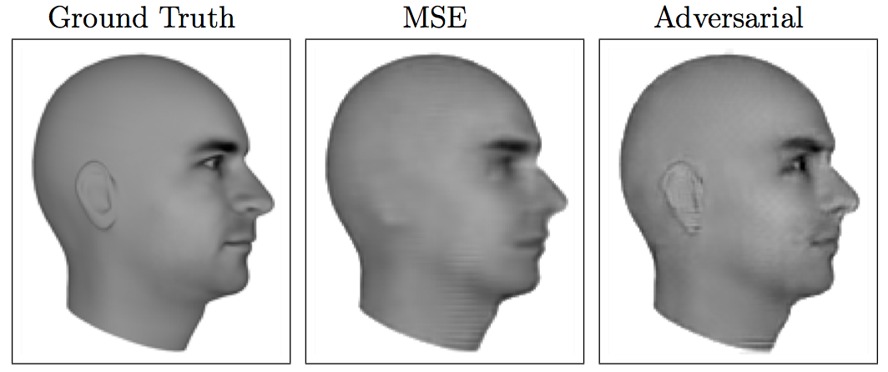
Next Video Frame Prediction
(Lotter et al 2016)
Notes:
GANs allow many answers

Slide 11
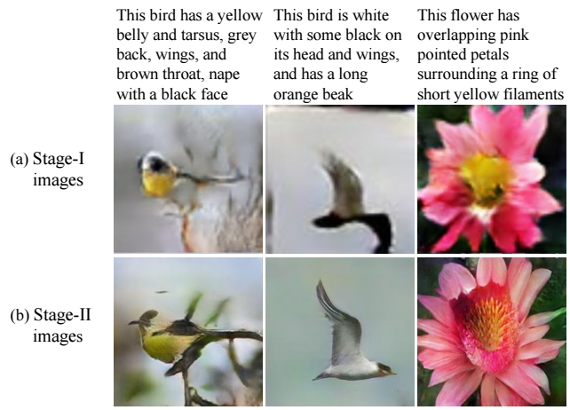
Text to Photo-realistic Image Synthesis (StackGan)

Slide 12
Why study generative models?
Simulate possible futures for planning or simulated RL
Realistic generation tasks
Missing data
Semi-supervised learning

Slide 13
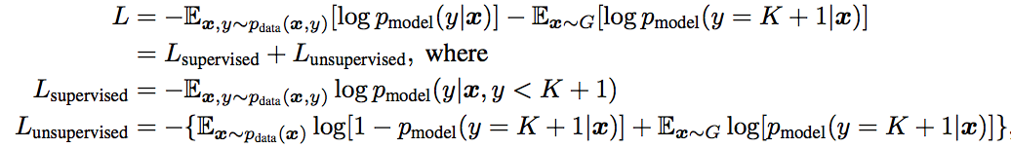
Semi-supervised learning
Idea: labeling sample from Generator with a new “generated” class y = K + 1.
Result: On MNIST, achieve 99.14% accuracy with only 10 labeled examples per
class (vs 60,000 labelled samples).
(OpenAI, 2016)

Slide 14
Roadmap
Why study generative models?
How do generative models work? GANs and its variants?
Research frontiers

Slide 15
How do generative models work? GANs and its variants?
General formulation
Intuitions
Adversarial Nets Framework
DCGAN

Slide 16
How do generative models work? GANs and its variants?
General formulation
Intuitions
Adversarial Nets Framework
DCGAN

Slide 17
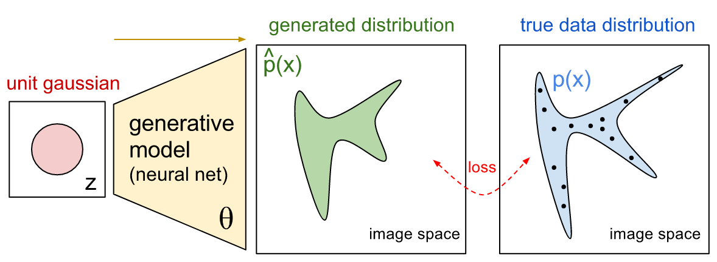
General formulation

Slide 18
How do generative models work? GANs and its variants?
General formulation
Intuitions
Adversarial Nets Framework
DCGAN

Slide 19
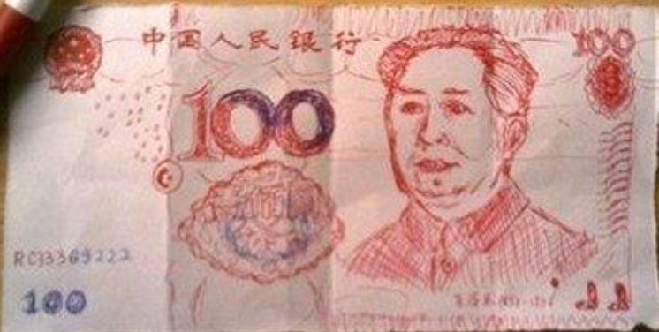
Intuitions
Crook

Slide 20
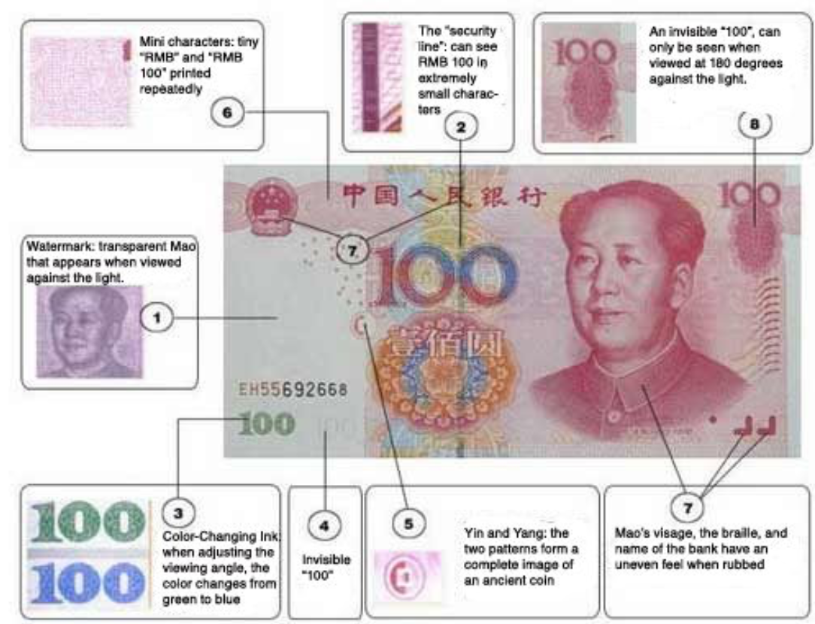
Intuitions
Crook
Teller

Slide 21
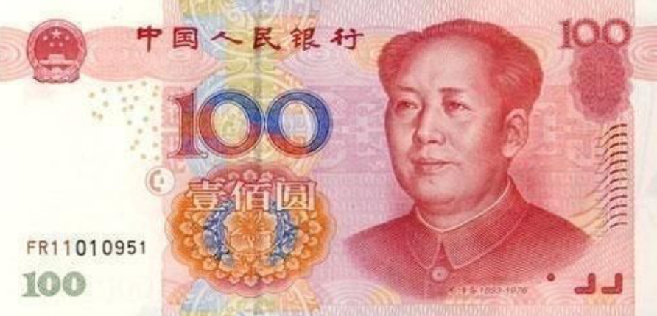
Intuitions
Crook
Teller

Slide 22
Intuitions
Crook tries the best to cheat the teller by generating more realistic cash
Teller tries the best to distinguish whether the cash is generated by crook or not

Slide 23
How do generative models work? GANs and its variants?
General formulation
Intuitions
Adversarial Nets Framework
DCGAN

Slide 24
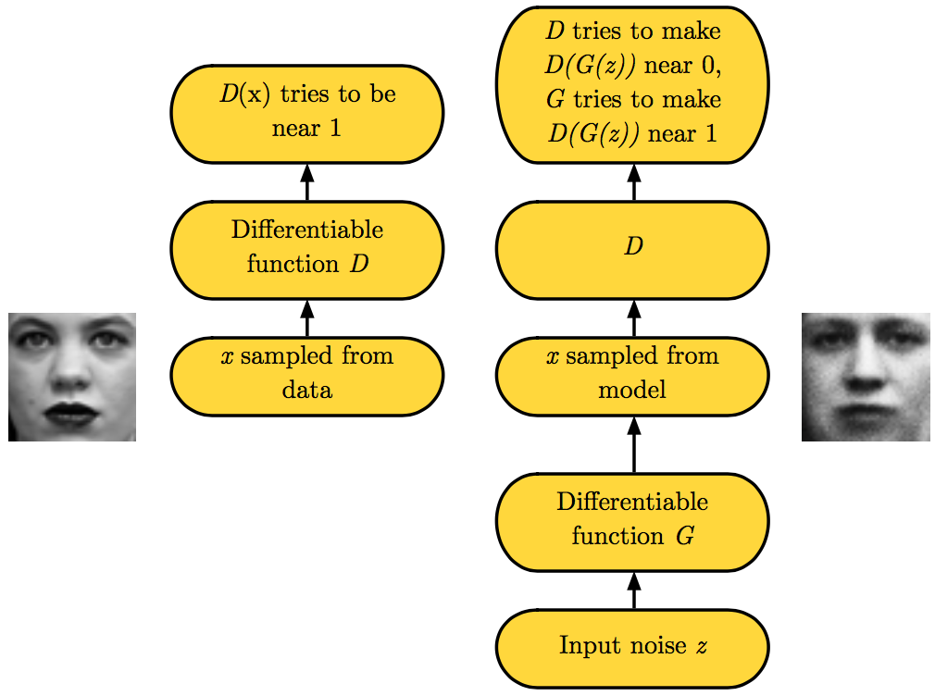
Adversarial Nets Framework

Slide 25
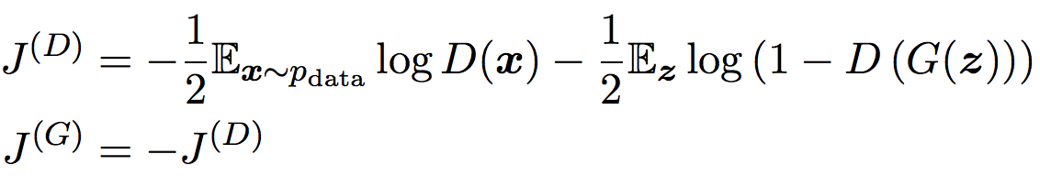
Minimax Game (objective)
Discriminator: real or fake, cross-entropy errors.
Generator minimizes the log-probability of the discriminator being correct.
Nash equilibrium is a saddle point of the discriminator loss.

Slide 26
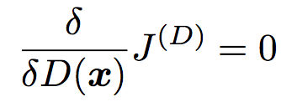
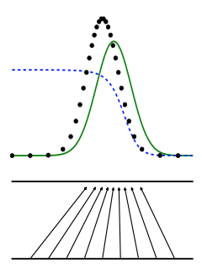
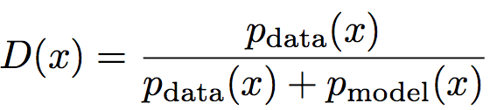
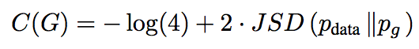
Discriminator Strategy
Assume both densities are nonzero everywhere,
Optimal D(x) for any p_{data}(x) and p_{model}(x) is always,
Data distribution
Discriminator
Model distribution
x
z

Slide 27
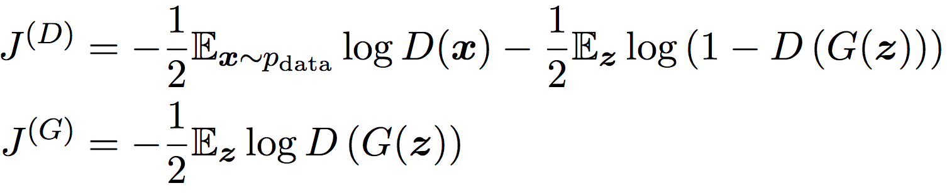
Non-Saturating Game
Generator maximizes the log-probability of the discriminator being
mistaken.
Heuristically motivated; generator can still learn even when discriminator
successfully rejects all generator samples

Slide 28
Training Procedure
Use SGD-like algorithm of choice (Adam) on two minibatches simultaneously:
A minibatch of training examples
A minibatch of generated samples
Optional: run k steps of one player for every step of the other player.
Notes:
一个是xx采样自训练数据，另一个是zz采样自模型的隐变量先验。 然后两个求导过程被同时执行： 一个是更新θ(D)θ(D)来最小化J(D)J(D), 另一个是更新θ(G)θ(G)来最小化J(G)J(G)
使用同步梯度下降，并对每一个玩家分别进行单步优化

Slide 29
How do generative models work? GANs and its variants?
General formulation
Intuitions
Adversarial Nets Framework
DCGAN

Slide 30
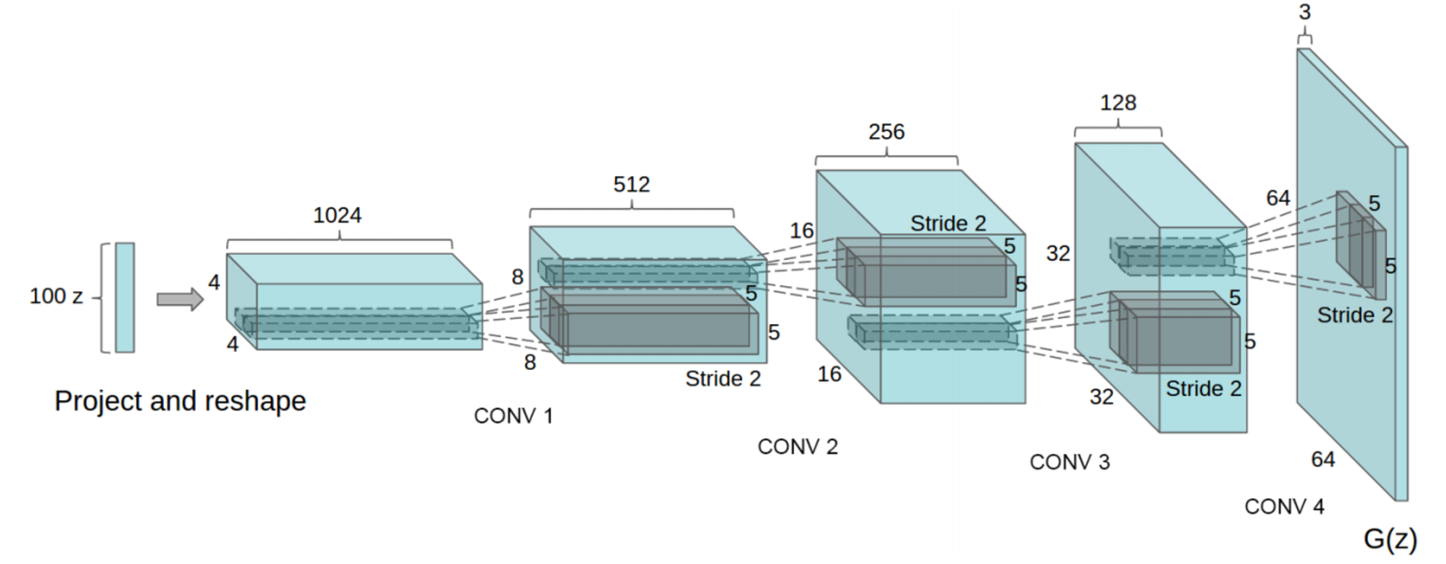
DCGAN
(Radford et al 2015)

Slide 31
DCGANs for MINIST

Slide 32
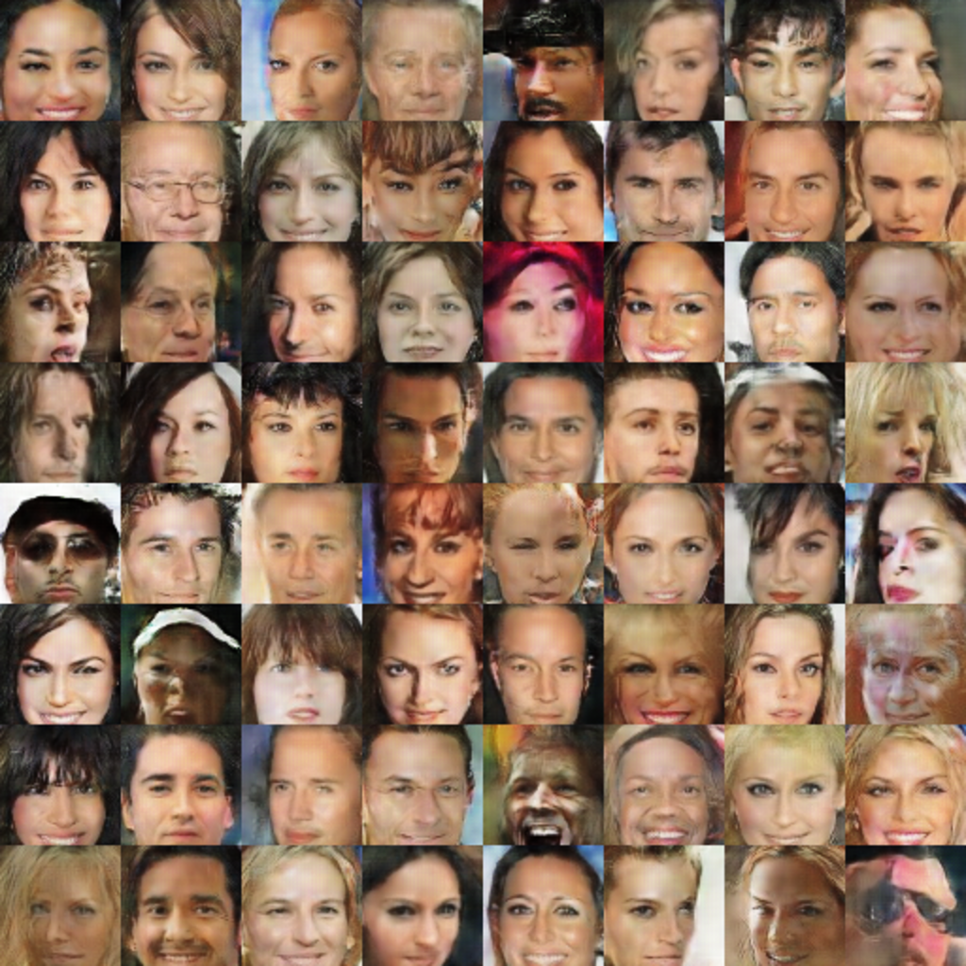
DCGANs for celebA

Slide 33
Roadmap
Why study generative models?
How do generative models work? GANs and its variants?
Research frontiers

Slide 34
Research frontiers
Non-convergence
Wasserstein GAN

Slide 35
Research frontiers
Non-convergence
Wasserstein GAN

Slide 36
Non-convergence
Game solving algorithms may not approach an equilibrium at all
We represent G and D as highly non-convex parametric functions
Mode collapse: most severe form of non-convergence

Slide 37
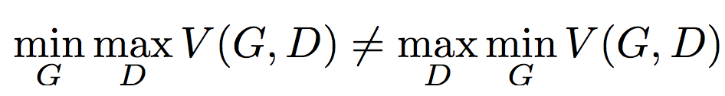
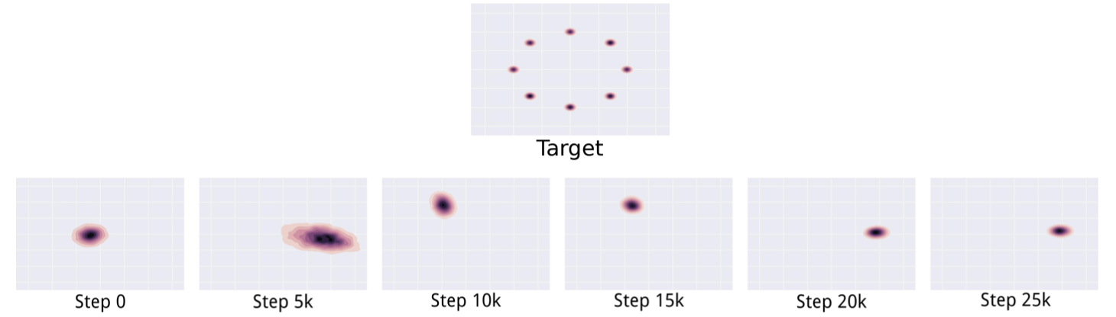
Mode collapse
Minibatch Features

Slide 38
Research frontiers
Non-convergence
Wasserstein GAN

Slide 39
Wasserstein GAN
Jensen-Shannon Divergence -> Wasserstein Divergence

